Slide 1
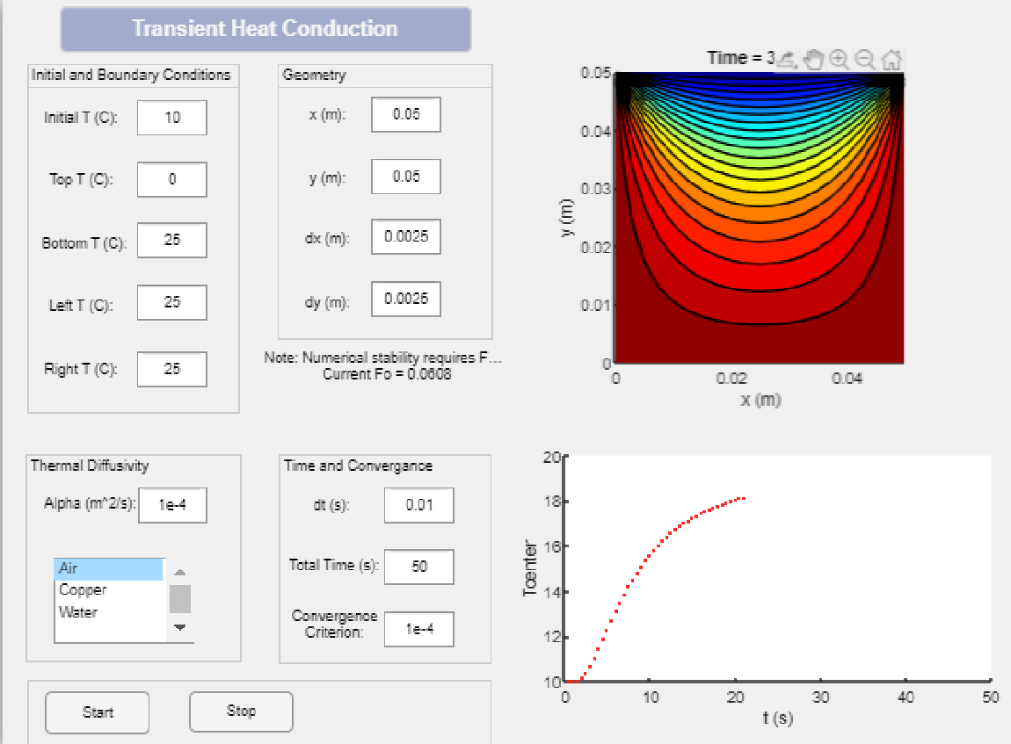
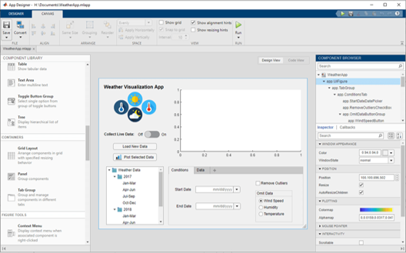
App Building Challenge
MATLAB App Designer
2-hr event
1hr App Building Onramp Party
Release problem statement: 1hr Challenge
Problem Statement (Beginner & Advanced):
Chemical Equations
Thermodynamic Equations
More coming soon..
Plot basic equations and visualise by interacting with dials, sliders etc
Time taken to create an app: 10 mins
Easy to organise and evaluate
Win Prizes !!

